Slide 1

What Insights do we get from the data?
PRDA-04 Customer Segmentation Analysis in Istanbul malls
By Haidar Ali Shaik
Project Team ID: PTID-CDA-NOV-23-069

Slide 2

Project Statement and Scope
To develop comprehensive report on customer segmentation to identify patterns and trends in the client’s dataset
The report tries to explain the various groups affecting the revenue generated by different shopping malls in Istanbul
This project serves as the first step for customer segmentation allowing to optimize simple but effective marketing strategies
Different advanced analysis like ‘RFM analysis’ and ‘customer behaviour prediction’ are out of the scope as the given data includes only unique customer information. These techniques can only be performed when there are multiple transactional data for the customers
Notes:
Primary goal of this project is to build a comprehensive cx segmentation report for my clients to enable to them to find patterns and trends.
I try to explain how various cx groups affect the revenue generated from the shopping malls
This report equips my clients to make simple but effective marketing strategies
But since the dataset have no customer making multiple transactions, we cannot perform advanced analytics like RFM analysis or customer behaviour prediction which requires cx to have made multiple purchases at different periods of time

Slide 3




Data Overview
Key Questions
Data shows transactional history of unique customers at different shopping malls in Istanbul from 2021 to 2023
Attributes include unique customer id and invoice date and invoice id, quantity of item purchased and price of each unit, name of shopping mall, age and gender of the person making the transaction, method of payment and category of the product purchased
Performed SQL data exploration and found no duplicate rows and null cells in the data
How is the shopping distribution according to gender?
Which gender did we sell more products to?
Which gender generated more revenue?
Distribution of purchase categories relative to other columns?
How is the shopping distribution according to age?
Which age cat did we sell more products to?
Which age cat generated more revenue?
Distribution of purchase categories relative to other columns?
Does the payment method have a relation with other columns?
How is the distribution of the payment method?
Database: Project_customer_segmentation
Table: customer
Notes:
First of all, I accessed the dataset by connecting to the database called.. And then the table in it called customer.

Slide 4
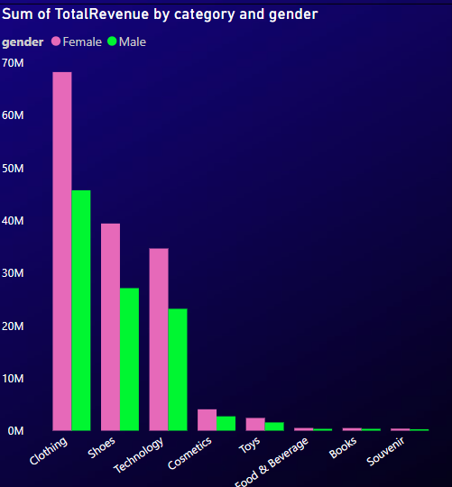
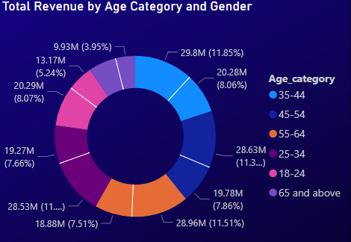
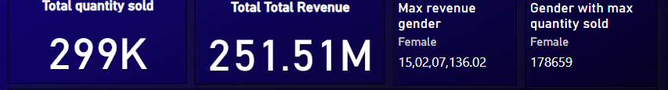
Key Insights for overall dataset
Total quantity sold is 299k products
Total revenue from these products is 251.51M TL(Turkish Currency is Lira [abbreviated as TRY or TL])
Customers from 35-44 age category generated highest sales and revenue with over 50M TL as revenue and over 58k quantities sold to the same age group
Customers with 45-54 age category generated second highest revenue
Clothes generate highest revenue overall

Slide 5
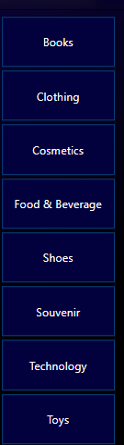
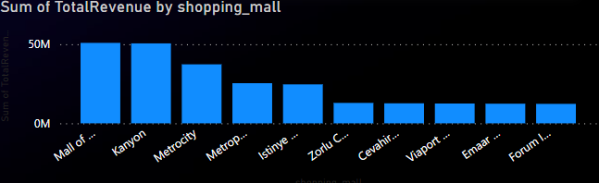
Shopping Distribution
By looking at 2.5 years of transactional data, we are able to identify that Mall of Istanbul and Kanyon mall generates the most revenue, hence the focus of this presentation
Mall of Istanbul consists 350 stores including luxury local and international brands. It is the most famous mall in turkey. Hence also an attractive place customers would prefer to visit
Kanyon mall consists of luxury brands with expensive products. It has 160 stores. In addition, like Mall of Istanbul, it has theatres, restaurants, bars, fitness clubs etc. It is one of the biggest malls in istanbul

Slide 6
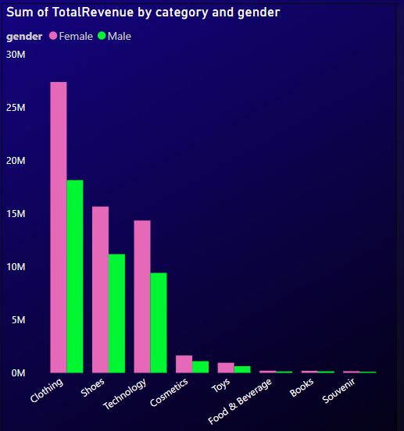
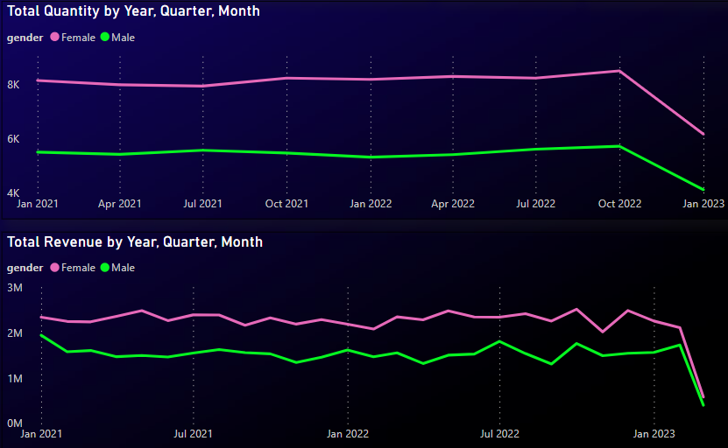
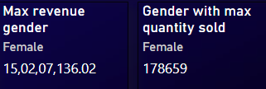
Shopping Distribution by Gender
Max sales and revenue are generated by Female gender
Clothes generated overall highest sales and revenue from 2021 to 2023 followed by shoes
Female revenue from clothes is almost 20M TL more than Male revenue generated from clothes
In every category, revenue from females is always higher than male

Slide 7
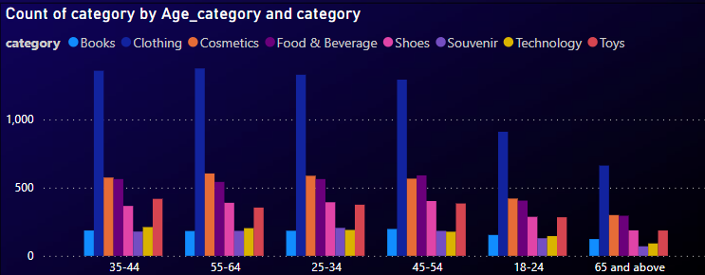
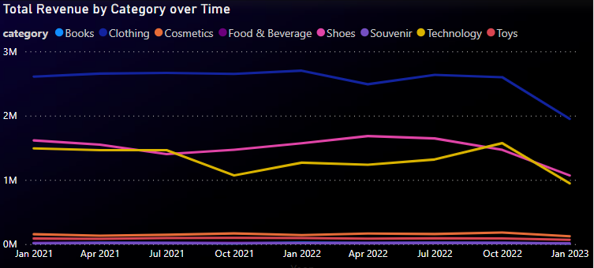
Shopping Distribution by Category
Clothes generate the highest revenue in every age category
There is fall in sales for all the categories from 2022 Quarter 4 to 2023 quarter 1
More customers buy cosmetics and food & beverage, but the revenue is higher from shoes and technology
Revenue for every category started going down between 2022 quarter 4 and 2023 quarter 1, most likely because of recession

Slide 8

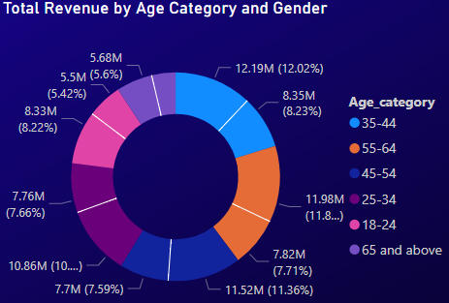
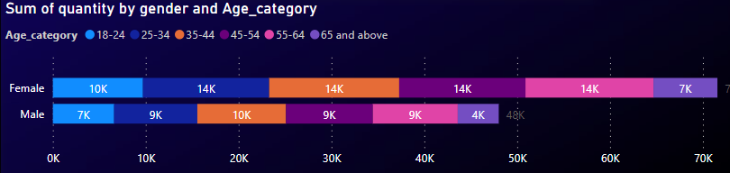
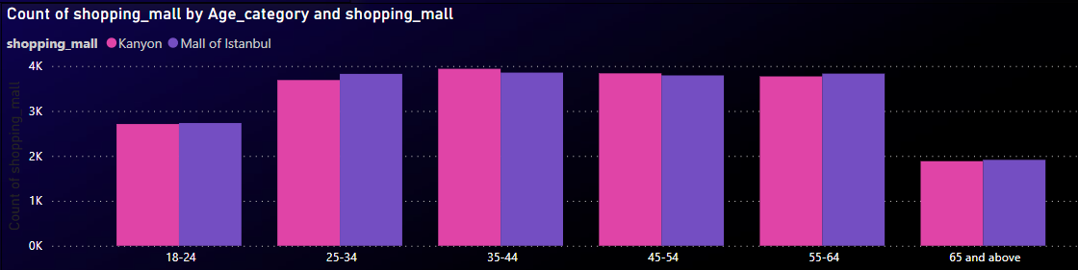
Shopping Distribution by Age Category
Customers from 35-44 age category generated highest sales and revenue, with over 20.5M TL as revenue and over 24k quantities sold to the same age group
Most customer who shop are also in the same age category
Even among this age category, females bought more products than males

Slide 9
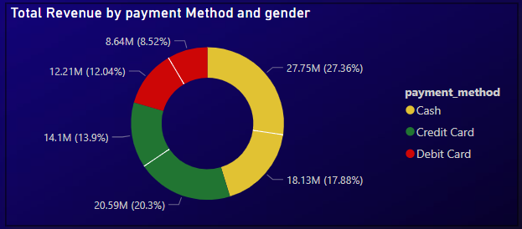
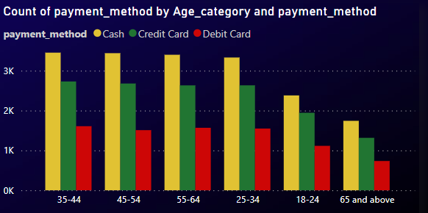
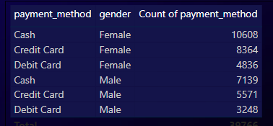
Shopping Distribution Payment Method
Most customers buy products using cash with over 10.6k females making cash payments while only 7.4k male made payments via cash
Next most common method of payment is via credit card

Slide 10
Prescriptive Analysis
Instead of trying improve sales from souvenir, malls can try giving discounts on technology
Bundled offers can be promoted on clothes
Discounts can be promoted on off-season clothes
Setup more stores for clothes, technology and, shoes should increase revenue further
Price matching will boost sales for different categories
Buy 1 get 1 offers on products aimed at females can improve sales
Promote cash back or loyalty rewards to payment by credit or debit as customers might not always have enough cash to buy the products they wish
Implementing self-check-out can increase the likelihood of customer buying all items in their cart
Adding payment options like crypto wallet and QR code scan increases payment convenience and might increase sales
Sending shopping experience feedback survey to customers after check-out will provide direct points of focus
Discounts and offers targeting customers with 25-64 years of age can lead to more sales as they are also the segment of customers visiting the malls the most.

Slide 11

Conclusion
We were able to extract some key insights for decision making and were able to suggest BI intelligence solutions to increase revenue
Using the Power BI report, my clients can get answers to more questions they might have and formulate marketing strategies
Future
If the dataset had multiple transactions from customers over the years, we:
Can perform RMF analysis to target customers if the dataset had multiple transactions from customer
Can using clustering algorithms to predict whether a customer who purchased product A would buy another product from the category list

